Slide 1




NEXT GEN EMPLOYABILITY PROGRAM
Creating a future-ready workforce
Team Members
College Name
Student Name : JEEVA E I
Student ID : AU513521104018
ANNAI MIRA COLLEGE OF
ENGINEERING AND TECHNOLOGY

Slide 2

CAPSTONE PROJECT SHOWCASE
Project Title
Building Bus Reservation System using Python and Django
Abstract | Problem Statement | Project Overview | Proposed Solution | Technology Used | Modelling & Results | Conclusion

Slide 3
Abstract : Bus Reservation System in Django
The provided code consists of multiple HTML templates that form the user interface and functionality of a Bus Reservation System.
The templates extend a base template that provides a consistent layout and navigation structure across the entire website.
The base template includes a responsive navigation bar with links to different sections of the application, such as Home/Login, Find Bus, See Bookings, and conditional links for user logout or registration.
The templates leverage Django's template inheritance and URL template tags to ensure a modular and efficient codebase.
They also integrate with Django's authentication system and messaging framework for user authentication and displaying success/error messages.
Overall, these templates form the core user interface components of the Bus Reservation System, enabling users to search for buses, make bookings, view and manage their bookings, and perform authentication-related tasks.
Source :

Slide 4
Problem Statement
Develop a web-based application that allows users to search for available bus routes, book tickets, view their bookings, and manage their reservations.
The application should provide a user-friendly interface and seamless integration with the backend systems for managing bus schedules, seat availability, and user authentication.
The Bus Reservation System should be developed using the Django web framework, leveraging its built-in features for routing, templates, forms, models, and database integration.
The provided HTML templates serve as the starting point for building the user interface components, while the backend functionality, including data processing, business logic, and database operations, should be implemented using Django's Model-View-Template (MVT) architecture.
Source :

Slide 5
Project Overview
The Bus Reservation System is a web-based application developed using the Django framework, designed to provide users with a convenient platform for searching, booking, and managing bus tickets online.
The system aims to streamline the process of bus travel by offering a user-friendly interface and seamless integration with backend systems for managing bus schedules, seat availability, and user authentication.
The Bus Reservation System is built using the Django web framework, taking advantage of its powerful features for routing, templates, forms, models, and database integration. The provided HTML templates serve as the foundation for building the user interface components, while the backend functionality, including data processing, business logic, and database operations, is implemented using Django's Model-View-Template (MVT) architecture.
The project follows best practices for web development, including separation of concerns, code reusability, and scalability. It is designed with a focus on security, implementing measures to protect user data and prevent unauthorized access or misuse of the system.
Source :

Slide 6
Proposed Solution
The Bus Reservation System will be developed as a Django web application, leveraging the Model-View-Template (MVT) architecture and various built-in features of the framework. The solution will address the key requirements outlined in the problem statement, providing a user-friendly interface and seamless integration
with the backend systems for managing bus schedules, seat availability, and user authentication.
User Authentication:
Implement a user authentication system using Django's built-in authentication system. Create a user registration form where new users can enter their email, mobile number, username, and password to create an account.
Bus Search:
Create a form where users can enter the source, destination, and travel date to search for available buses. Develop a view function to handle the bus search request and query the database for matching bus schedules.
Source :

Slide 7
Bus Listing:
Render a template to display the list of buses matching the user's search criteria.
Booking:
Integrate a booking form within the bus listing page, allowing users to select a bus and specify the number of seats to book. Develop a view function to handle the booking request, verify seat availability, and create a new booking record in the database.
Booking Confirmation:
Render a template to display a confirmation message and the booking details after a successful booking. Include options for the user to view the booking details or proceed to the next step.
Responsive Design:
Utilize Bootstrap's responsive grid system and CSS styles to ensure that the user interface is responsive and accessible across different devices and screen sizes.
Source :

Slide 8
The proposed solution will follow best practices for web development, including separation of concerns, code reusability, and scalability.
The application will be organized into different components, such as models, views, templates, and URL routes, following the MVT architecture.
Throughout the development process, emphasis will be placed on writing clean, maintainable, and well-documented code.
Unit tests will be implemented to ensure the correctness and reliability of the application's functionality.
The solution will leverage Django's ORM (Object-Relational Mapping) for interacting with the database, which will store information about users, bus schedules, and bookings.
The database schema and models will be designed to efficiently handle the required data and relationships.
Overall, the proposed solution aims to provide a robust and user-friendly Bus Reservation System by leveraging the power and flexibility of the Django web framework, while adhering to industry best practices and security standards.
Source :

Slide 9


Technology Used
Front-end
Back-end
Source :

Slide 10
Modelling & Results
The Bus Reservation System, built using the Django web framework, provides a user-friendly interface and robust functionality for users to search, book, manage, and cancel bus reservations.
The system ensures data integrity and security while adhering to industry best practices and leveraging Django's powerful features for efficient web application development.
The Bus Reservation System, built with Django's MVT architecture, provides a comprehensive solution for users to search, book, manage, and cancel bus reservations.
The models store user, bus, and booking information, while the views and templates handle the application logic and user interface, respectively. The system ensures data integrity, security, and a user-friendly experience.
Source :

Slide 11
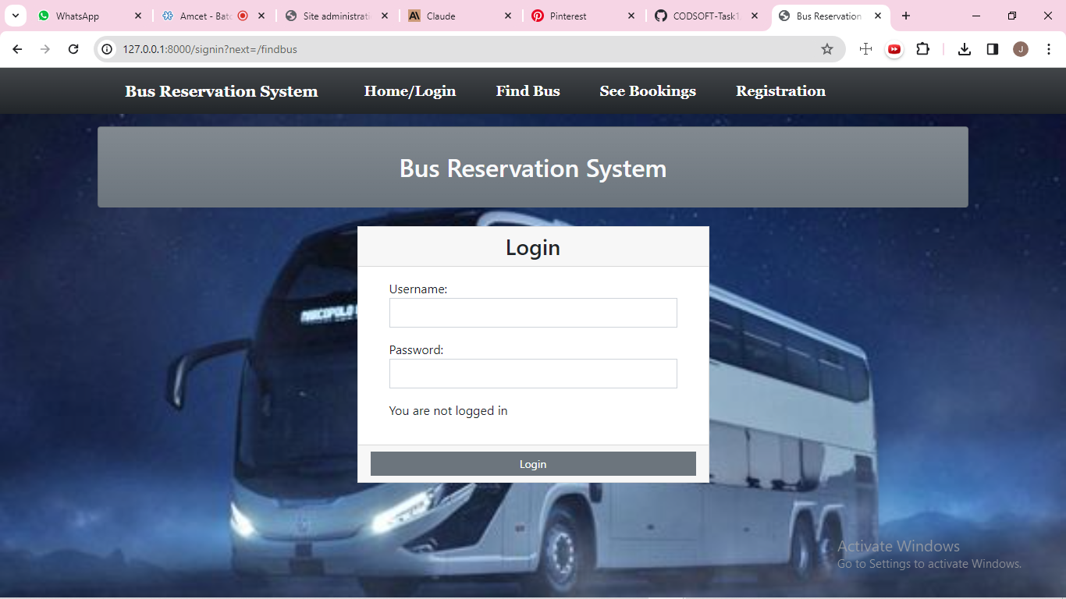
Homepage

Slide 12
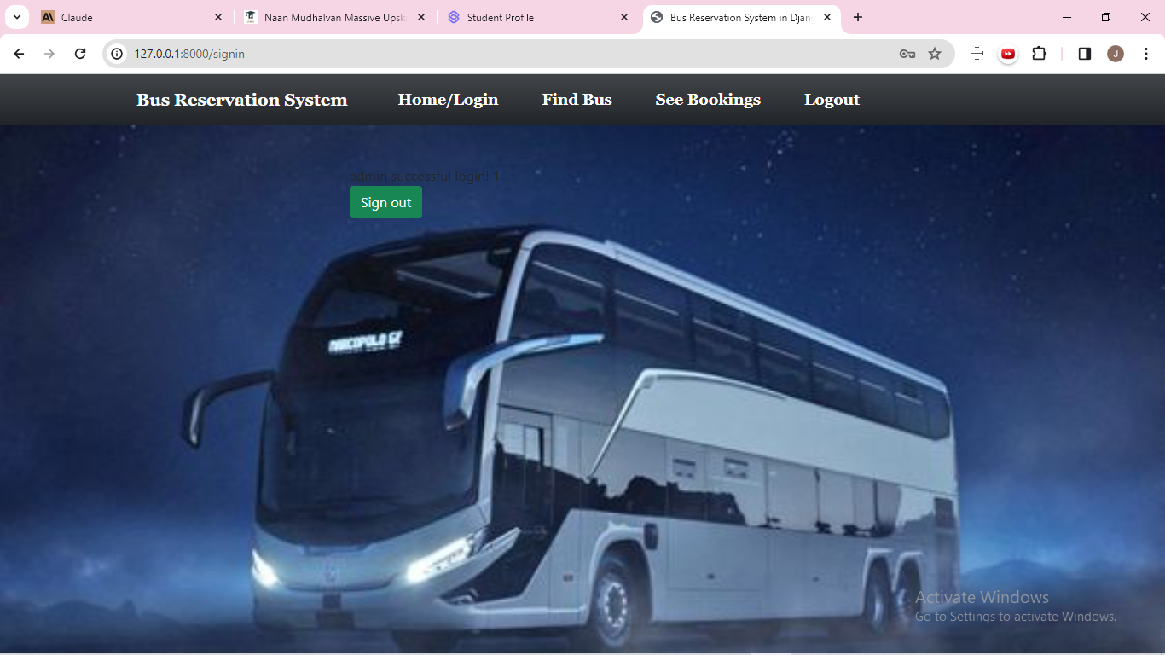
About-Us-Page

Slide 13
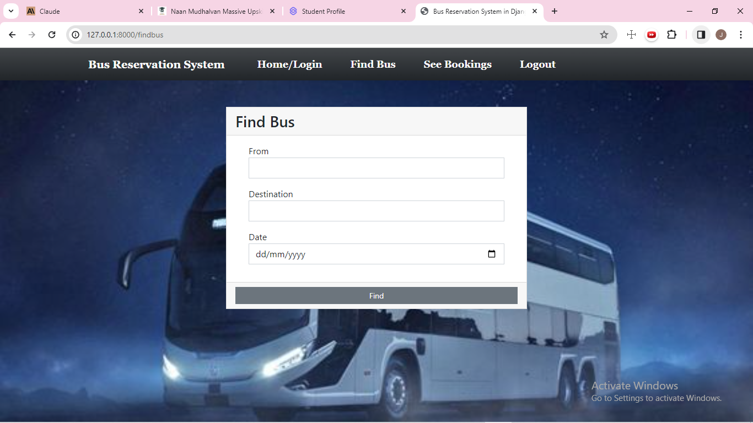
Service-Page

Slide 14
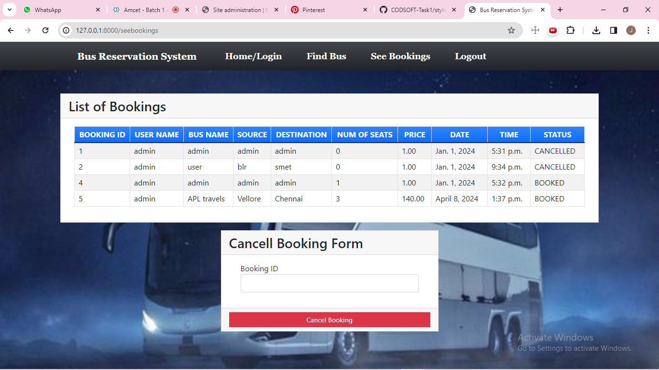
Departments-Page

Slide 15
Future Enhancements:
Here's a concise summary of potential future enhancements for the Bus Reservation System built using Django:
Mobile app development
Payment integration techniques
Real time bus tracking
Seat selection
Personalized recommendations
Social media integration

Slide 16
Conclusion
In conclusion, the implementation of a bus reservation system utilizing the Django framework offers a comprehensive solution for managing and streamlining the booking process. Through the utilization of Django's robust features such as its ORM, authentication system, and built-in security measures, the system ensures efficiency, reliability, and security in handling reservations.
The development process involved careful planning, meticulous design, and rigorous testing to ensure a user-friendly interface and seamless functionality.
By leveraging Django's modular structure, the system can be easily customized and scaled to accommodate varying needs and future enhancements.
Overall, the bus reservation system built on Django empowers both administrators and users with a hassle-free experience, optimizing the booking process while maintaining data integrity and security.
As technology continues to evolve, this system stands poised to adapt and evolve alongside, continuously providing a reliable platform for bus reservation management.
Source :

Slide 17
Thank You!
Notes:
Thank You !!

